Slide 1


World Bank Data: Analysis of Global Population
INTRODUCTION
Exploring population trends across regions and countries
By: Aaryan Babuta

Slide 2
DATA ACQUISITION
INTRODUCTION
The study of population is the foundation for understanding human history, progress, and our collective future.
Today, with the world's population exceeding eight billion people, the conversation is shifting from just a simple count to a deeper analysis of the dynamics at play. The field of demography examines the forces that drive these changes
World Bank Data: Analysis of Global Population

Slide 3
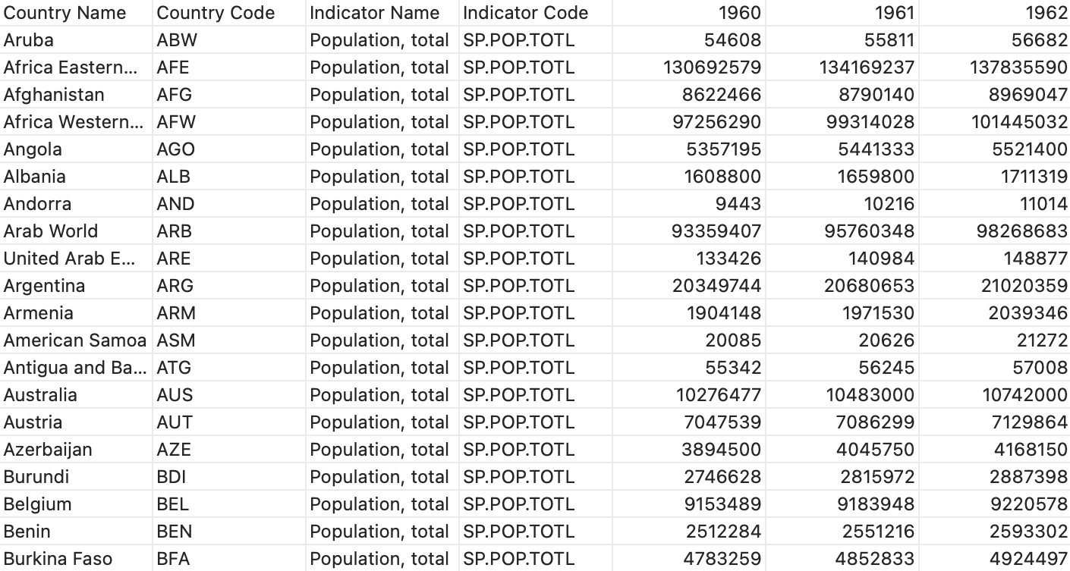
DATA PREPROCESSING AND CLEANING
DATA ACQUISITION
INTRODUCTION
a foundational dataset was sourced from the World Bank's open data repository, a globally recognized and reliable source for economic and demographic statistics. The data Format: CSV (Comma-Separated Values), contained time-series population figures, which were critical for the analysis.
1. LIBRARY AND DATA IMPORT
World Bank Data: Analysis of Global Population

Slide 4
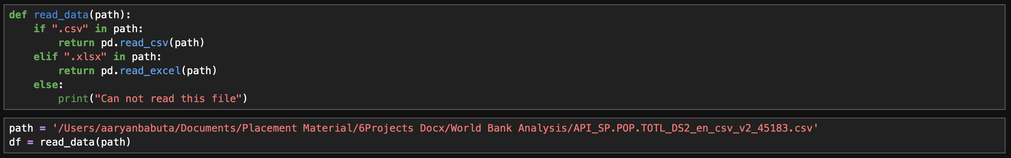
INTRODUCTION
DATA PREPROCESSING AND CLEANING
DATA ACQUISITION
1. LIBRARY AND DATA IMPORT
The data preprocessing phase was a critical and foundational step for preparing the dataset for reliable analysis. Raw data, even from authoritative sources, often contains inconsistencies, missing values, and formatting issues that can skew results.
Therefore, a meticulous preprocessing workflow Is essential to ensure the dataset was clean, complete, and uniform, guaranteeing the accuracy and integrity of all subsequent analytical and visualization tasks.
The following key steps were performed:
World Bank Data: Analysis of Global Population

Slide 5
INTRODUCTION
DATA PREPROCESSING AND CLEANING
DATA ACQUISITION
1. LIBRARY AND DATA IMPORT
Following Python libraries were used for data manipulation and visualization:
pandas: provided the high-performance DataFrame structure, which was used to load the World Bank's dataset and perform key operations such as filtering, aggregating, and merging data.
NumPy: provided efficient array objects and a vast collection of mathematical functions that were leveraged for calculations.
matplotlib.pyplot: used for generating a variety of plots, forming the foundation of all charts created.
seaborn: seaborn was used in conjunction with matplotlib to enhance the visual appeal of the plots.
World Bank Data: Analysis of Global Population

Slide 6
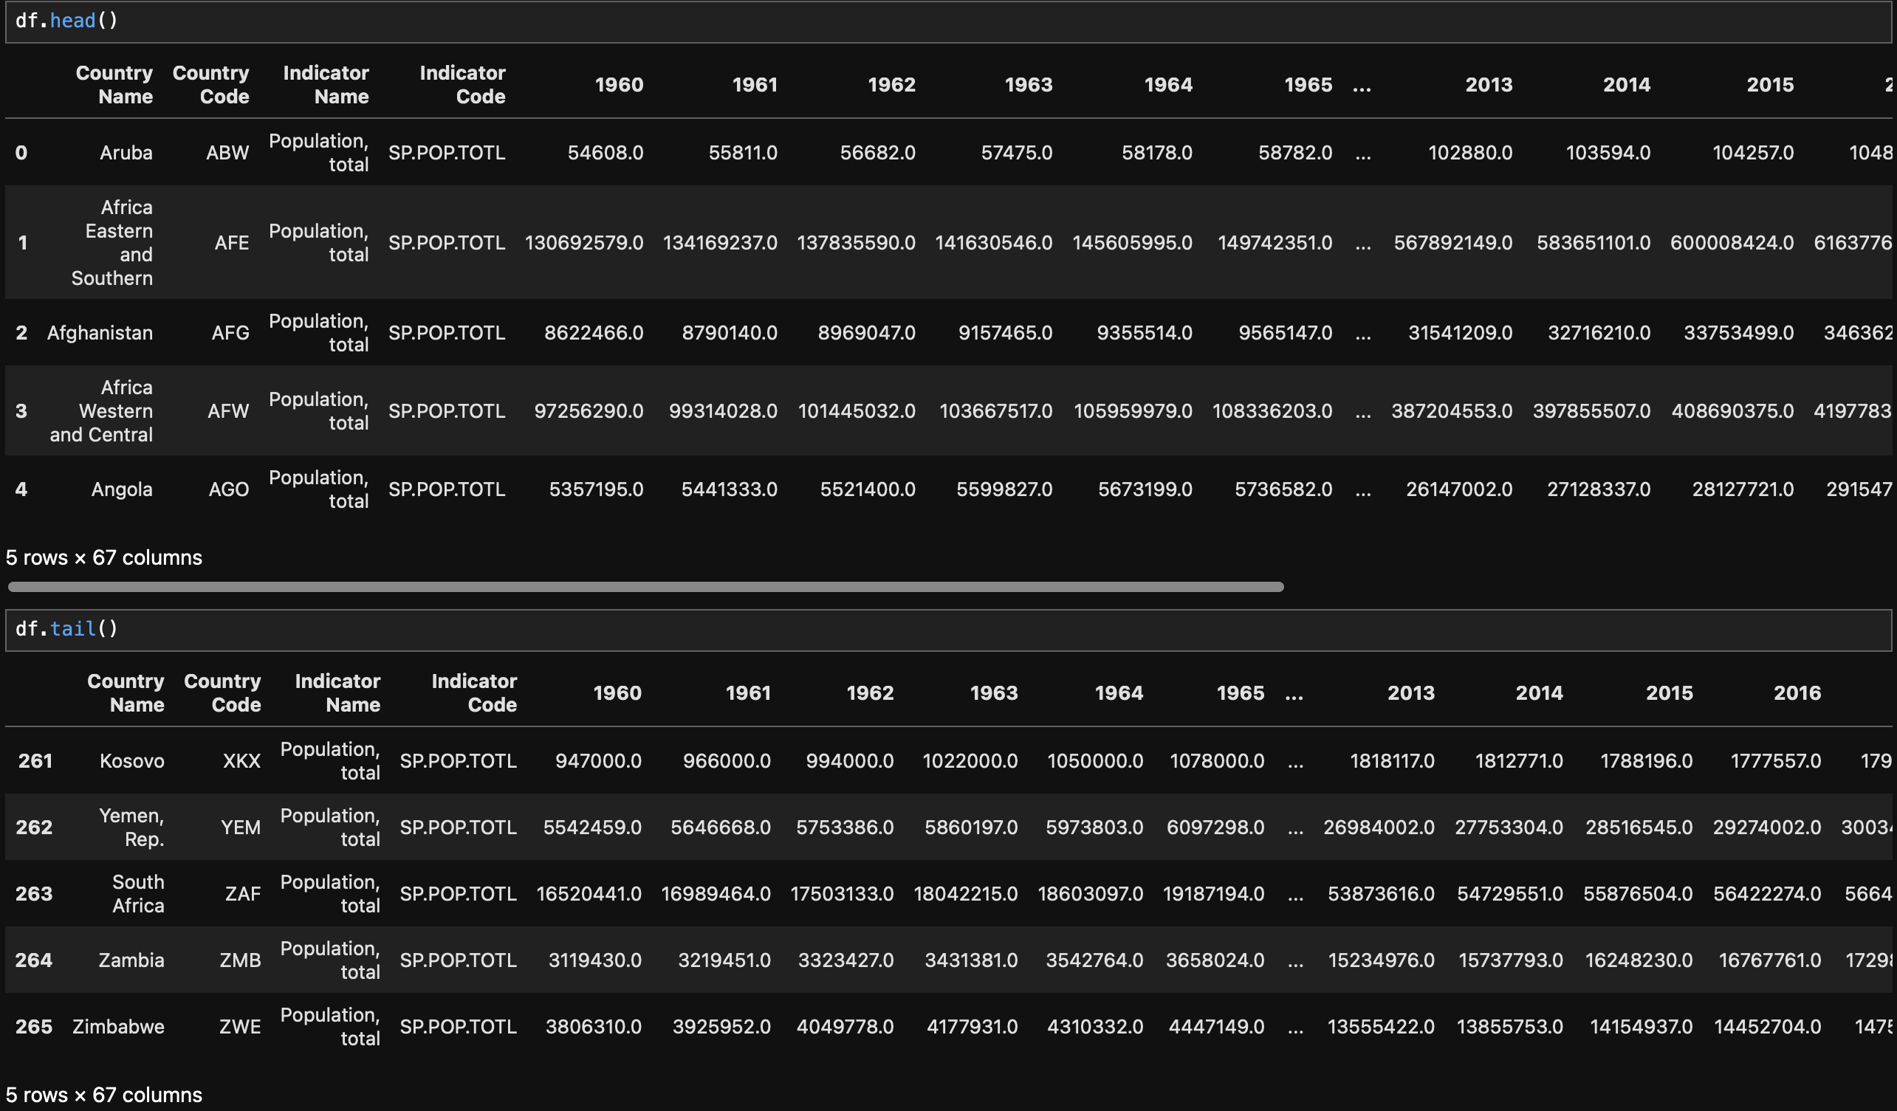
INTRODUCTION
DATA PREPROCESSING AND CLEANING
DATA ACQUISITION
2. INITIAL DATA INSPECTION
The dataset previewed with df.head() and df.tail() shows 67 columns containing annual population data (1960–2016) for countries and regions.
World Bank Data: Analysis of Global Population

Slide 7
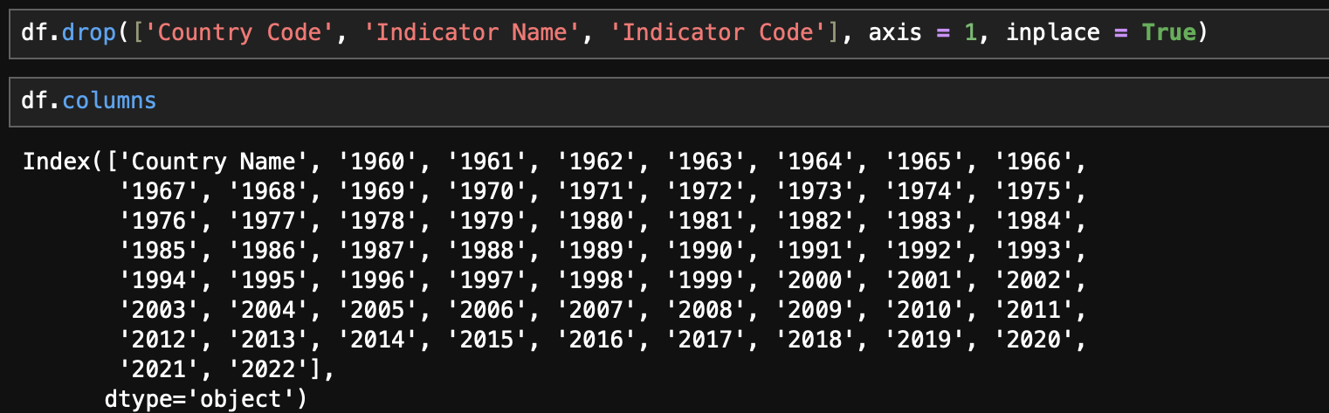
INTRODUCTION
DATA PREPROCESSING AND CLEANING
DATA ACQUISITION
3. ATTRIBUTE SELECTION
Irrelevant columns (Country Code, Indicator Name, Indicator Code) were removed to simplify the dataset. The cleaned data now contains only Country Name and yearly population columns for focused analysis.
World Bank Data: Analysis of Global Population

Slide 8
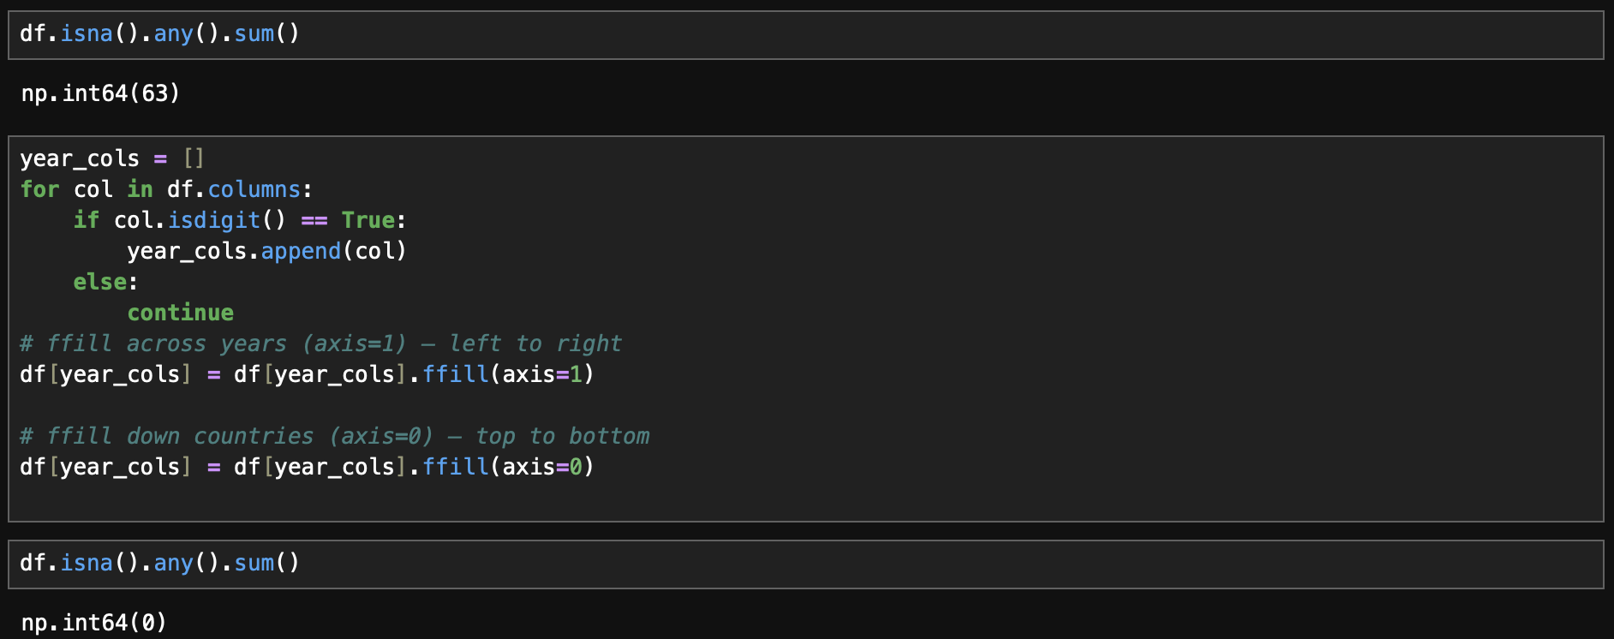
INTRODUCTION
DATA PREPROCESSING AND CLEANING
DATA ACQUISITION
4. HANDLING MISSING VALUES
Missing values were addressed using forward-fill across years followed by forward-fill down countries, ensuring complete data continuity.
World Bank Data: Analysis of Global Population
A subsequent validation confirmed the absence of any remaining null values.

Slide 9

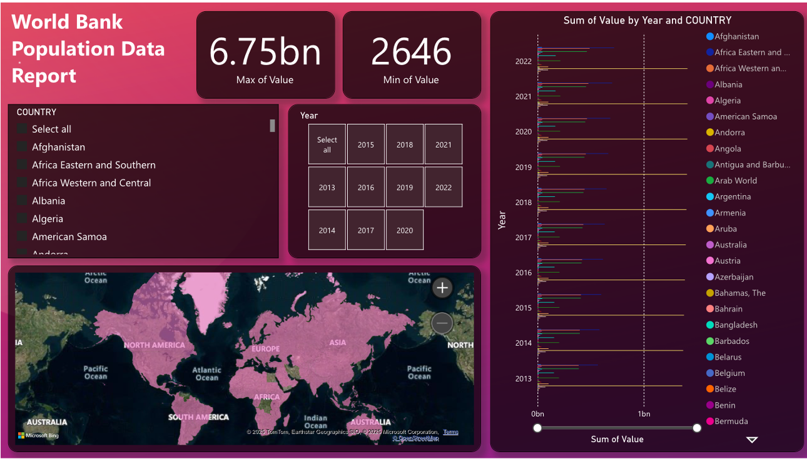
REPORT
World Bank Data: Analysis of Global Population

Slide 10
CONCLUSION
Summary: The analysis offers a comprehensive overview of global population distribution patterns.
Impact: Insights from the findings can guide demographic planning, optimize resource allocation, and inform evidence-based policy decisions.
Applications: Useful for governments, NGOs, and international bodies to forecast needs and plan interventions.
Future Outlook: Provides a foundation for predicting demographic changes and preparing long-term strategies.
World Bank Data: Analysis of Global Population

